Slide 1
AR toolkit
Ki Hwan Kim

Slide 2
Introduction
What is ARToolKit?
The ARToolKit augmented reality works as follows
How to work?
Limitations
Example Video
Conclusions

Slide 3

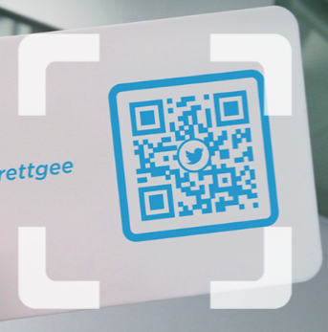
What is ARToolKit?
An open-source computer tracking library for creation of strong augmented reality applications that overlay virtual imagery on the real world.
In order to create strong augmented reality, it uses video tracking capabilities that calculate the real camera position and orientation relative to square physical markers or natural feature markers in real time.

Slide 4
The ARToolKit augmented reality works as follows
The camera captures video of the camera view and sends it to the computer.
Software on the computer searches through each video frame for any square shapes (square markers).
If a square marker is found and the image content embedded by the square, the pattern, is matched and identified, the software uses mathematics to calculate, relative to the camera, both the position of the black square and the pattern orientation .
Once the position and orientation of the camera are known, a computer graphics model is drawn using an offset to the calculated position and with a matching orientation.
This model is drawn in the foreground of the captured video and tracked against the movements of the background video causing the model to appear attached to the background.
The final output is shown back in the display, so when the user looks through the viewer, they see the rendered graphic model over a real world video stream; seemingly homogeneous with the camera view.

Slide 5
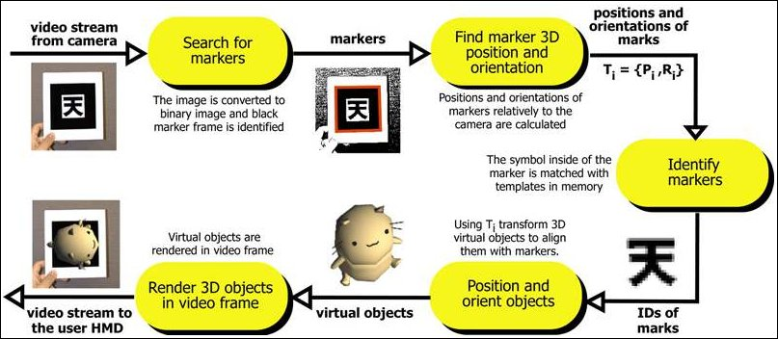
The ARToolKit augmented reality works as follows

Slide 6
How to work?
A square marker is made up of a light colored, surrounding, **padding**, usually white, surrounded by a thick dark colored, usually black, **border** and an embedded, high contrast, image content, referred to as a **pattern**. The pattern is what makes a square marker unique.

Slide 7
Limitations
Occlusion
Range
Marker's Planar Orientation to the Camera
Lighting Conditions

Slide 8
Limitations 1. Occlusion
If users cover up, from the camera's view, part of the marker with an obstruction, the composited virtual model disappears.

Slide 9
Limitations 2. Range
since as markers are move further away from the camera, the markers occupy fewer pixels in the camera's view and results in having insufficient detail for recognition, tracking and identification.

Slide 10
Limitations 3. Marker's Planar Orientation to the Camera
Tracking is also affected when the orientation of the two dimensional plane that the marker lies on is not perpendicular to camera's view.

Slide 11
Limitations 4. Lighting Conditions
Overhead lights may create reflections and glare spots on a paper marker and so make it more difficult to find the marker square.

Slide 12
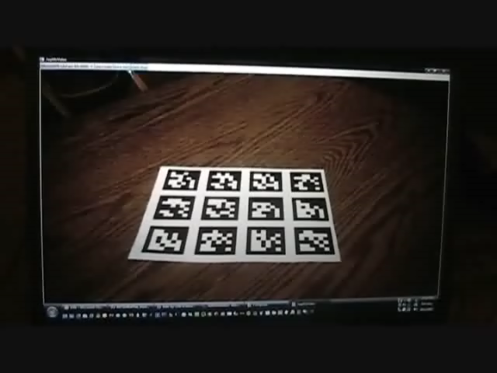
Example video (*.png, *.jpg)

Slide 13
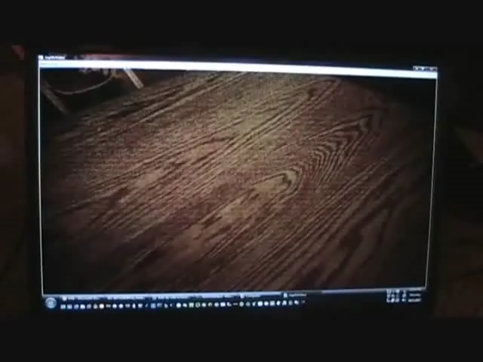
Example video (*.gif)

Slide 14
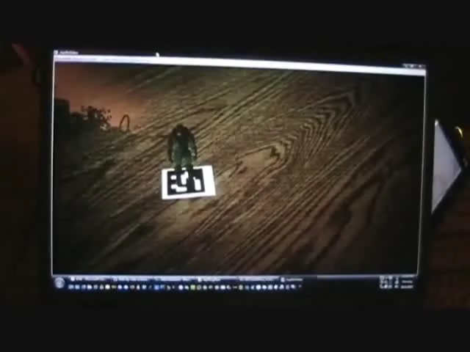
Example video (*.avi)

Slide 15
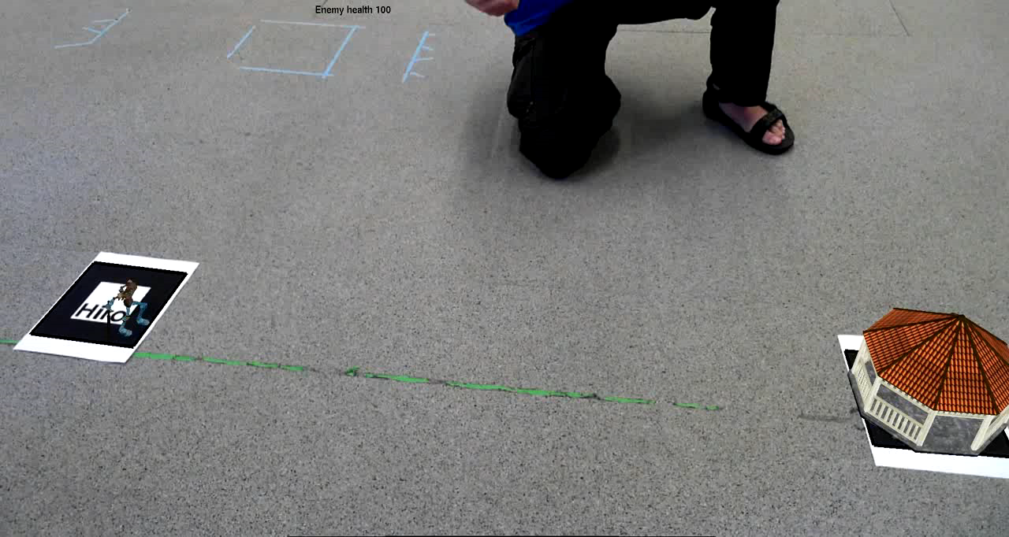
Example video (Simple game)

Slide 16
Conclusions
In the future, MR (Mixed Reality) and ARToolKit will combine to enable moving objects.

